Slide 1
Capstone Project-2 Transport Demand Prediction (Bus Tickets Sale Prediction)
Presented By-
Yashwati Patel

Slide 2

Content:
Problem Statement
Data Summary
Ride Origination Town
Travel Time
Quarterly Trend
Month Wise Booking Trends
Feature Engineering
ML Models And Metrics
Challenges
Conclusion

Slide 3

Problem Statement
Build a model that predicts the number of seats that Mobiticket can expect to sell for each ride,There are 14 routes in this dataset. Exploring 14 different towns to the North-West of Nairobi towards Lake Victoria and using the data provided by Bus ticket sales from Mobiticket, predicting the number of tickets that will be sold for Buses that ends into Nairobi.

Slide 4
Data Summary
Data is available for Nairobi through June 2018.This dataset includes the variables from 17 October 2017 to 20 April 2018
ride_id: unique ID of a vehicle on a specific route on a specific day and time.
seat_number: seat assigned to ticket
payment_method: method used by customer to purchase ticket from Mobiticket (cash or Mpesa)
payment_receipt: unique id number for ticket purchased from Mobiticket
travel_date: date of ride departure. (MM/DD/YYYY)
travel_time: scheduled departure time of ride. Rides generally depart on time. (hh:mm)
travel_from: town from which ride originated
travel_to: destination of ride. All rides are to Nairobi.
car_type: vehicle type (shuttle or bus)
max_capacity: number of seats on the vehicle.

Slide 5
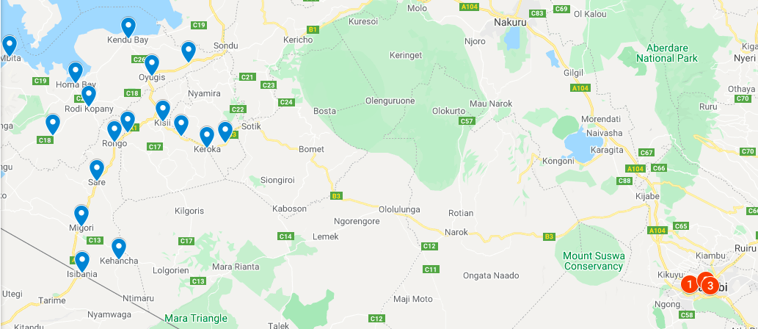
Map

Slide 6
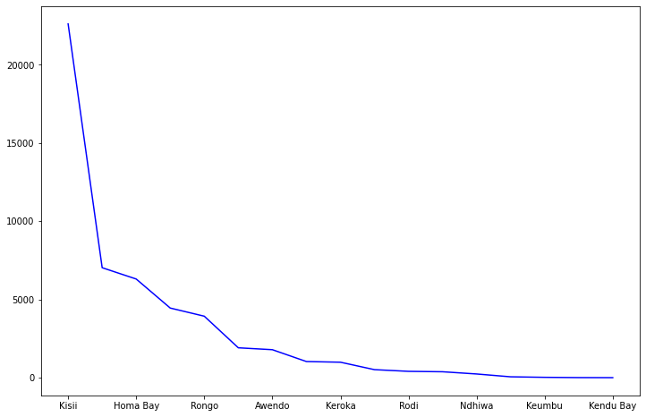
Ride Origination Towns
Here we can see that Kisii is the top place from where the most number of rides originate.

Slide 7
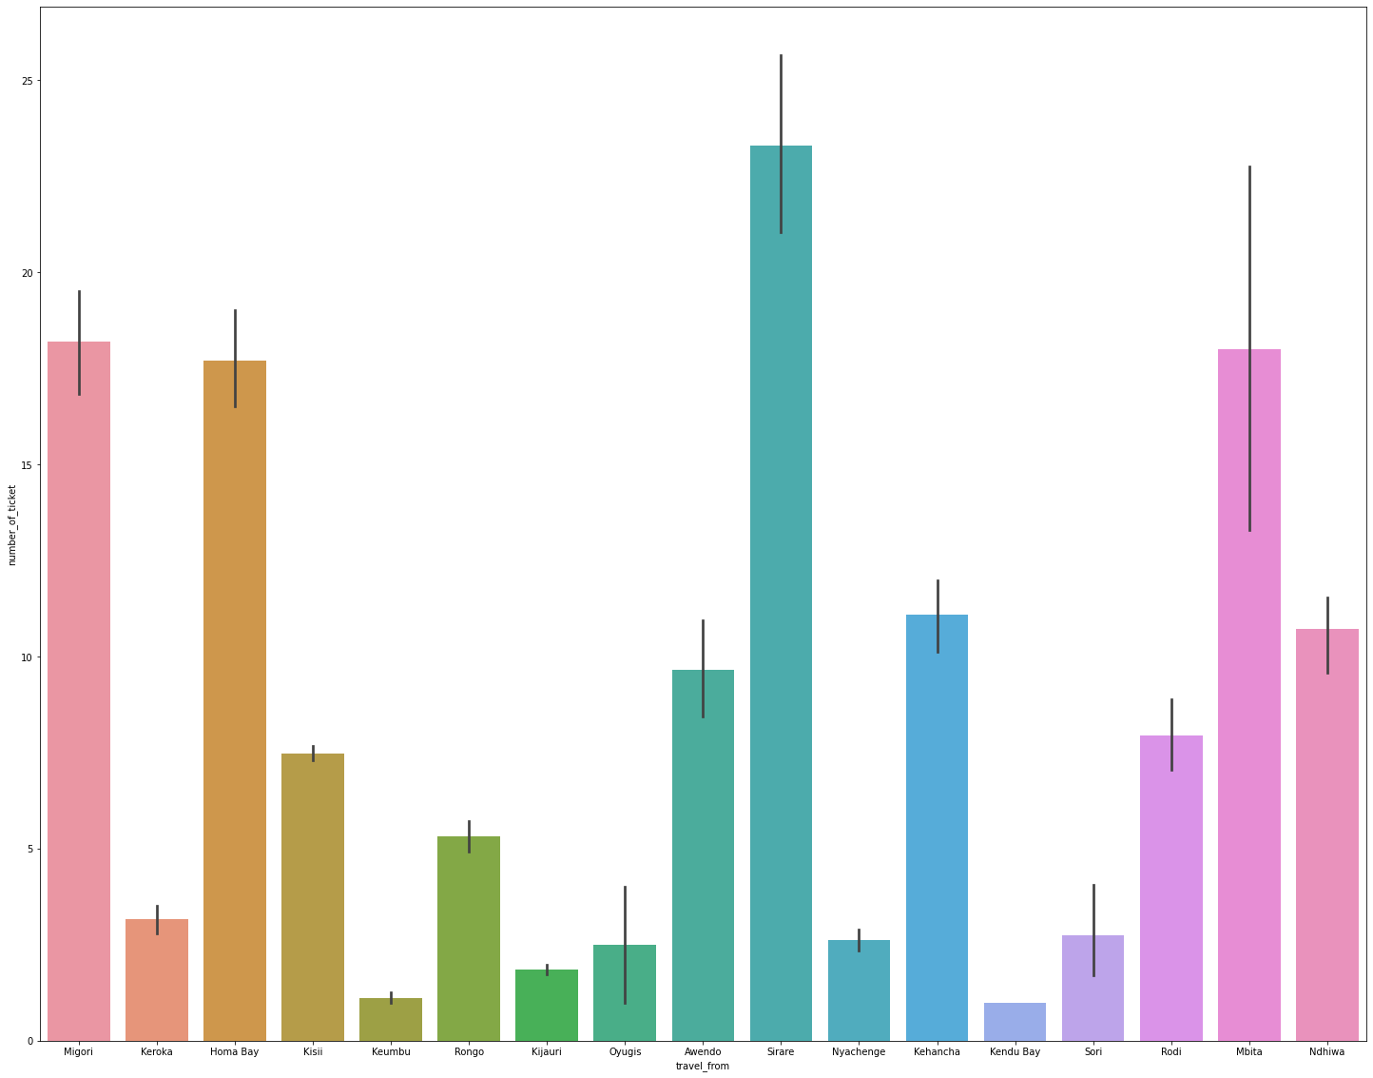
EDA Plot of travel_from vs number of tickets

Slide 8
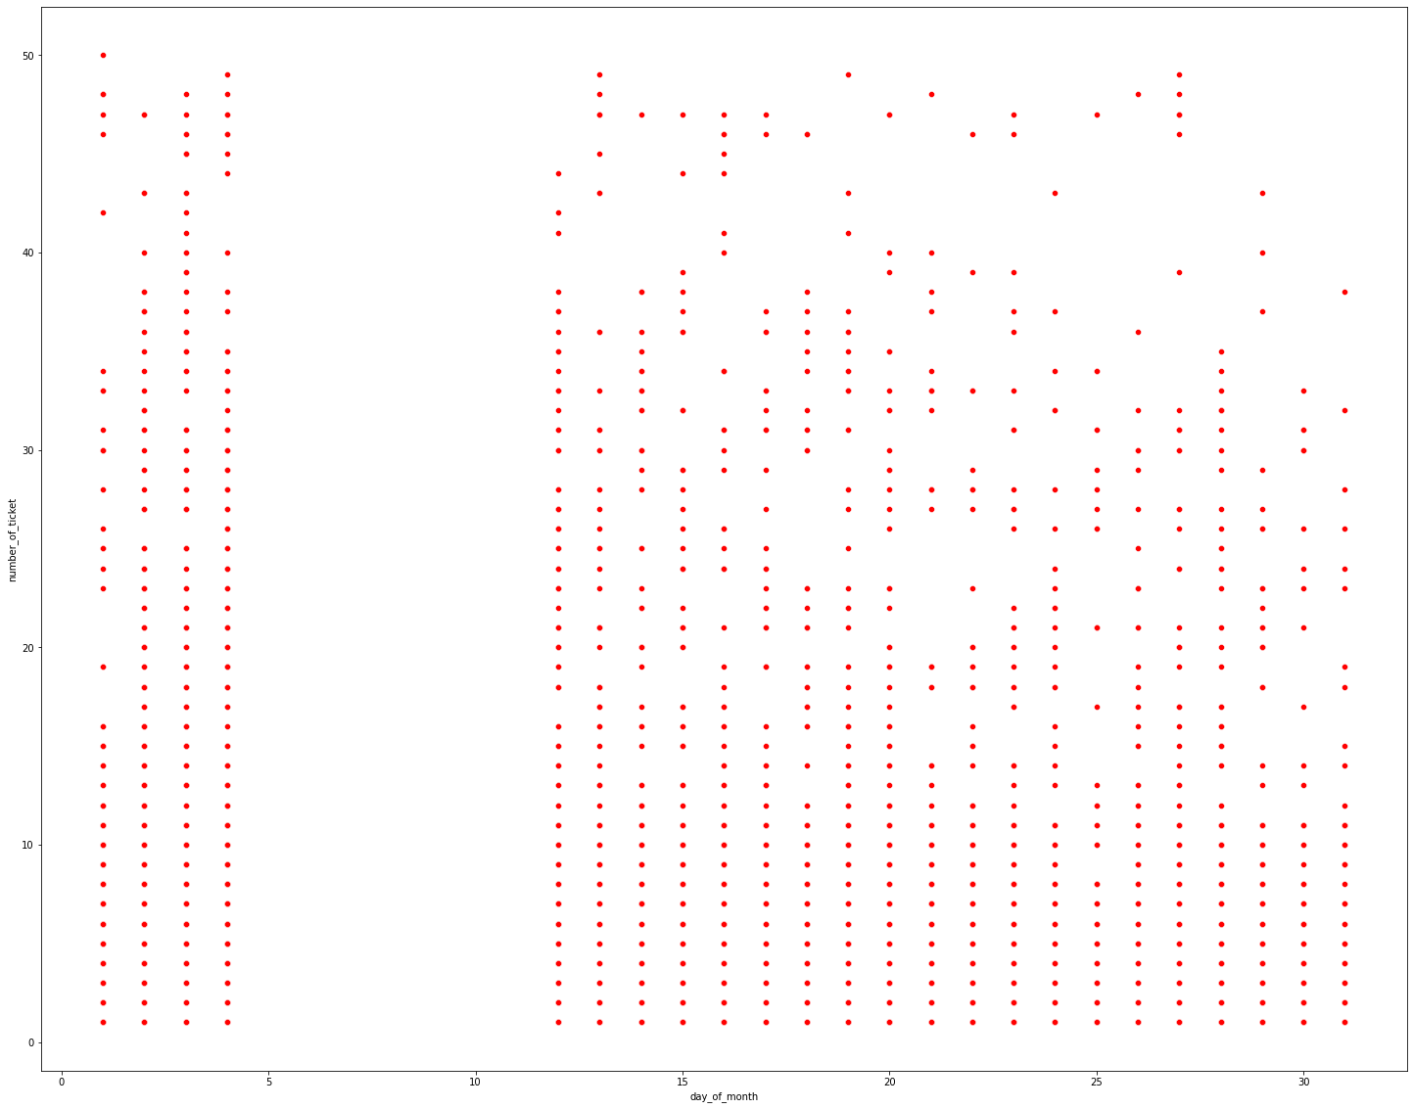
Day wise Travel Trend
we can see that there is the gap between 5 to 11 in the day of the month.
we can assume that there is official holyday of public transport between these days.we can say that the number of tickets in all the days of month are same.
Plot day_of_month vs number_of_tickets

Slide 9
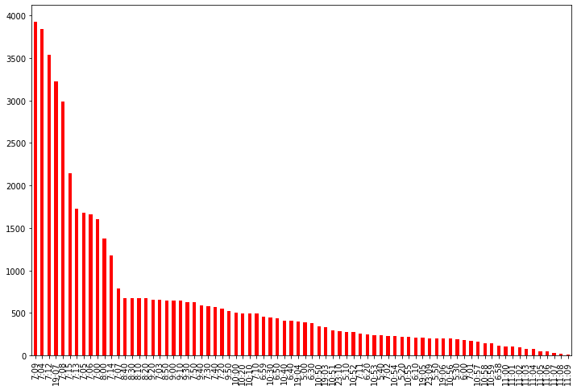
Travel Time
From this plot We can see Highest number of buses depart at around 7 AM in the Morning .

Slide 10
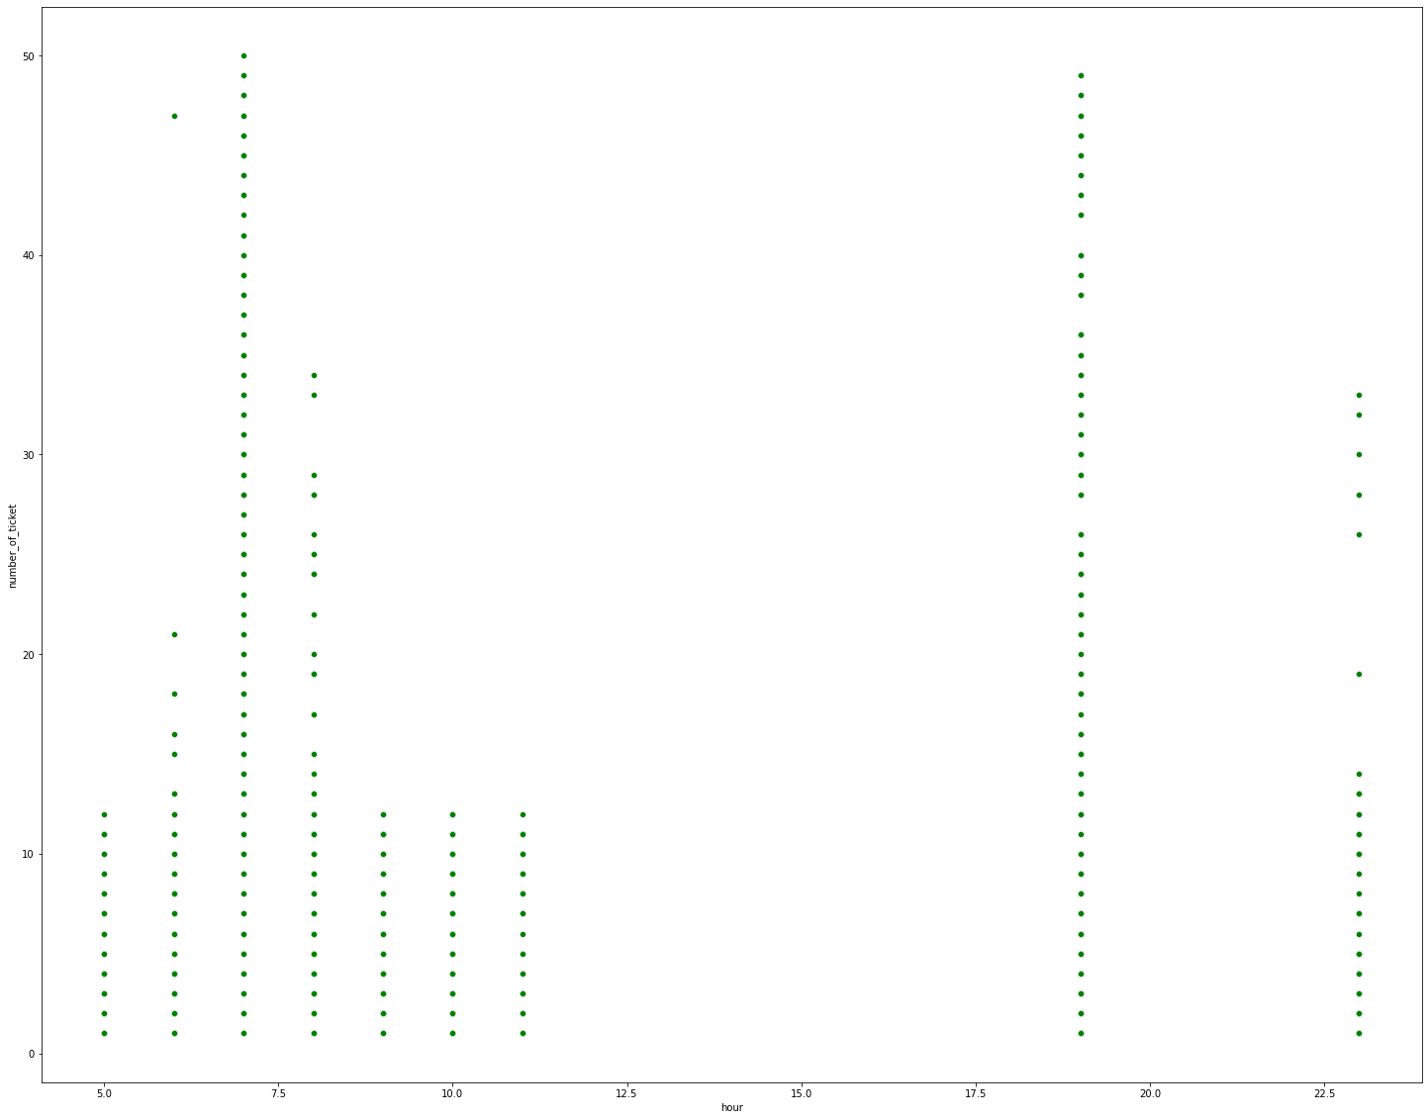
Hourly Travel Trend
We can see that most of the tickets were sold at 7AM and 8PM and that seems true because in morning most of the people go to the work and office.
Number_of_ticket vs Hour

Slide 11
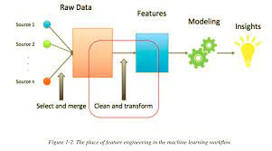
Feature Engineering Using domain knowledge to extract features from raw data, the performance of the model can be improved.
Speed
Travel_month
No_of_tickets
Travel_day
Hod_arrived_date
Is_rush_hour
Travel_from
Time_gap_between_buses
Travel_from_distance
Hourly_travelers
Daily_travelers

Slide 12
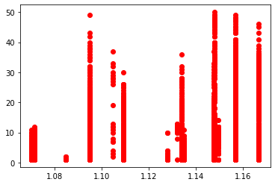
Variation of Number of Tickets with Speed
Number_of_ticket vs Speed

Slide 13
ML Models And Metrics
Type of Regression | Train Score | Test Score | R2 Score | ADJ_R2 | MAE | MSE
Linear | 0.41531 | 0.354621 | 0.354679831 | 0.3476561 | 4.7474791 | 48.4351195
Linear-Lasso | 0.293599 | 0.343606 | 0.355067 | 0.3487478 | 4.7417715 | 48.4241544
Linear-Ridge | 0.405354 | 0.3553535 | 0.3550673 | 0.3481087 | 5.026478 | 48.4015719
Gradient Boosting | 0.676331137 | 0.60851 | 0.6085084 | 0.6046721 | 3.540035 | 29.3904512
Random Forest | 0.62637829 | 0.623421 | 0.6234206 | 0.6152057 | 3.4301030 | 28.2619184
XGBoost | 0.84559453 | 0.84211254 | 0.84211254 | 0.8386682 | 2.2667203 | 11.8493008
Type of Regression | Train Score | Test Score | R2 Score | ADJ_R2 | MAE | MSE
Linear | 0.41531 | 0.354621 | 0.354679831 | 0.3476561 | 4.7474791 | 48.4351195
Linear-Lasso | 0.293599 | 0.343606 | 0.355067 | 0.3487478 | 4.7417715 | 48.4241544
Linear-Ridge | 0.405354 | 0.3553535 | 0.3550673 | 0.3481087 | 5.026478 | 48.4015719
Gradient Boosting | 0.676331137 | 0.60851 | 0.6085084 | 0.6046721 | 3.540035 | 29.3904512
Random Forest | 0.62637829 | 0.623421 | 0.6234206 | 0.6152057 | 3.4301030 | 28.2619184
XGBoost | 0.84559453 | 0.84211254 | 0.84211254 | 0.8386682 | 2.2667203 | 11.8493008

Slide 14
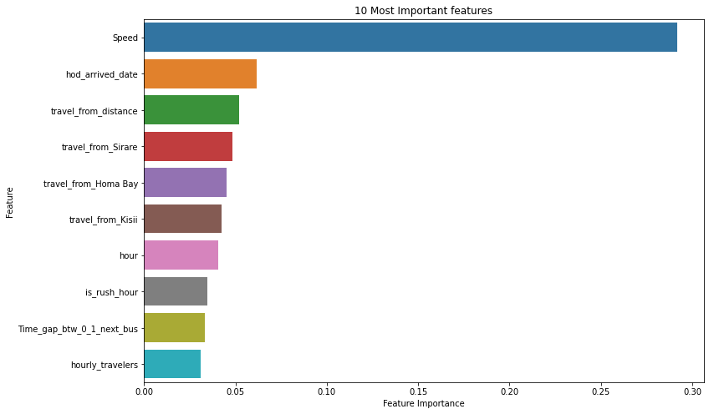
Feature Importance
10 Most Important Features

Slide 15
Challenges
To Find The Dependent Variable.
Feature Engineering.
Feature Selection.
Model Training And Performance Improvement.

Slide 16
Conclusion
Here in this whole process we used diffent type of regression algorithms to train our model. We have compared the performance of six different regression models. XGBoost regression model performed the best among them including the ensemble model proposed
with the lowest error rate. We pre-processed data to apply regression models for forecasting the speed of vehicles and distance between the source and destination.

Slide 17

Thank You !

